Slide 1

Code Refactoring and Bug Fixing
Revanth Christober M
February 27th 2024

Slide 2





About me
Driven Data Science Junior with a Passion for Impact
I'm a highly motivated and results-oriented individual currently pursuing my Senior Secondary from the National Institute of Open Schooling (NIOS).
This flexible learning environment fuels my passion for exploring data science and its transformative potential.
Ever since I was young, I've been fascinated by the power of data to change the world, and I'm eager to contribute to that change.
Through online courses (primarily using NPTEL) and dedicated self-study, I've built a strong foundation in data science and machine learning.
I'm not afraid to dive into challenging projects, and I've applied my skills to various real-world applications, including:
Income Classifier Model (Decision Tree) for Subsidy Inc. (89% accuracy)
Regression Model for Crypto Data Hourly Volume-Price Analysis and Prediction (81% accuracy)
Classification Model for Brazilian E-Commerce Public Dataset by Olist (92% accuracy)
Interactive Dashboard using Python and R (projects mentioned in your portfolio)
Beyond technical skills, I enjoy working in collaborative environments and connecting with people.
My friendly and proactive nature allows me to learn quickly and excel under pressure, even with the flexible learning model provided by NIOS.
I'm eager to leverage my data science skills to make a positive impact.
Contact me:

Slide 3
Agenda
About the Project
Bug Descriptions and their Resolution Approaches
Original Python Code
Refactored and Bug Fixed Python Code
Original HTML Code
Refactored and Bug Fixed HTML Code

Slide 4
About the Project
The Note Taking Application, developed by a team of aspiring data scientists, aimed to provide users with a platform for recording and managing their notes efficiently. However, due to their limited experience in backend development, the application encountered numerous challenges, resulting in a partially functional state. In response, I was assigned the task of refactoring the existing codebase and rectifying any issues to ensure smooth operation.
Upon initial assessment, several bugs were identified within the application. Firstly, the home route, which serves as the main interface for users, lacked proper functionality. It featured a text field for entering notes and a button for submission, but the process of adding notes and displaying them as an unordered list below the text field was flawed.
To address these issues, I proceeded with refactoring the codebase. One prominent issue was the lack of proper handling for user input. The application failed to capture the user's input from the text field and store it persistently. This was due to inconsistencies in the backend logic, particularly in the route handling and data storage mechanisms.
Additionally, the mechanism for displaying notes on the same page was not implemented correctly. The frontend lacked synchronization with the backend, resulting in an inability to fetch and render notes dynamically. This disconnect stemmed from improper integration between the Flask backend and the HTML frontend.
To mitigate these issues, I implemented a comprehensive solution. Firstly, I revised the route handling logic to accurately capture user input from the text field upon form submission. This involved updating the corresponding Flask route to retrieve the note content and store it persistently, ensuring that no data was lost during the process.
Furthermore, I improved the integration between the backend and frontend components to enable seamless communication and data exchange. This entailed updating the HTML template to dynamically render notes fetched from the backend, thereby ensuring that all added notes were displayed promptly and accurately to the user.
Throughout the debugging and refactoring process, meticulous attention was paid to identifying and addressing any additional issues that arose. This included thorough testing of the application's functionality to verify that all bugs were successfully resolved and that the Note Taking Application now operates seamlessly, providing users with a reliable platform for managing their notes effectively.

Slide 5
Bug Report and Resolution Report: Flask Notes Tasking App
Bug 1: Inadequate Handling of Form Submission
Description: In the original code, the form submission was not properly handled. The form action was not specified correctly, resulting in the form data not being processed.
Resolution Approach:
Modified the form action attribute to point to the root URL ("/") and specified the method as "POST" to ensure proper submission.
Utilized the Flask `request.form.get()` method to extract the note data from the submitted form.
Before:
After:
@app.route('/', methods=["POST"])
def index():
# Before
note = request.args.get("note")
notes.append(note)
return render_template("home.html", notes=notes)
@app.route('/', methods=["GET", "POST"])
def index():
if request.method == "POST":
# After
note = request.form.get("note")
if note:
notes = session.get('notes', [])
notes.append(note)
session['notes'] = notes
notes = session.get('notes', [])
return render_template("home.html", notes=notes)

Slide 6
Bug 2: Lack of Data Persistence
Description: In the original code, notes were stored in a list variable within the Flask application. However, this approach does not persist data across multiple sessions or server restarts.
Resolution Approach:
Implemented Flask's session management by setting a secret key (`app.secret_key`) to enable data persistence.
Utilized `session.get()` and `session['notes']` to store and retrieve notes data across different sessions.
Before:
After:
notes = []
@app.route('/', methods=["POST"])
def index():
note = request.args.get("note")
# Before
notes.append(note)
return render_template("home.html", notes=notes)
# After
app.secret_key = 'innomaticscoderefactorbugfixsecret'
@app.route('/', methods=["GET", "POST"])
def index():
if request.method == "POST":
note = request.form.get("note")
if note:
notes = session.get('notes', [])
notes.append(note)
session['notes'] = notes
notes = session.get('notes', [])
return render_template("home.html", notes=notes)

Slide 7
Bug 3: Incomplete HTML Structure
Description: The original HTML code lacked proper structure and semantic markup, potentially leading to rendering issues and accessibility concerns.
Resolution Approach:
Added appropriate HTML structure with `<head>` and `<body>` tags to ensure proper rendering and compatibility across browsers.
Included meaningful titles and headings (`<h1>` and `<h2>`) for better clarity and accessibility.
Before:
After:
<title>Notes Taking App</title>
</head>
<body>
<h1>Add a Note:</h1>
<form action="/" method="POST">
<input type="text" name="note" placeholder="Enter a note">
<button type="submit">Add Note</button>
</form>
<h2>Your Notes:</h2>
<ul>
{% for note in notes%}
<li>{{ note }}</li>
{% endfor %}
</ul>
<title>Document</title>
</head>
<body>
<form action="">
<input type="text" name="note"
placeholder="Enter a note">
<button>Add Note</button>
</form>
<ul>
{% for note in notes%}
<li>{{ note }}</li>
{% endfor %}
</ul>

Slide 8
Bug 4: Missing Form Submission Button
Description: In the original HTML code, there was no button specified within the form to submit the note data.
Resolution Approach:
Added a submit button within the form element to enable users to submit their notes effectively.
Set the button type attribute to "submit" to ensure it triggers form submission.
Before:
<form action="">
<input type="text" name="note" placeholder="Enter a note">
<button>Add Note</button>
After:
<h1>Add a Note:</h1>
<form action="/" method="POST">
<input type="text" name="note" placeholder="Enter a note">
<button type="submit">Add Note</button>

Slide 9
Bug 5: Incorrect HTTP Method Handling
Description: The original Flask route only handled POST requests, neglecting the possibility of GET requests.
Resolution Approach:
Updated the route decorator to accept both GET and POST requests to handle form submissions effectively.
Checked the request method within the route function to differentiate between GET and POST requests.
Before:
After:
# Before
@app.route('/', methods=["POST"])
def index():
note = request.args.get("note")
notes.append(note)
return render_template("home.html", notes=notes)
@app.route('/', methods=["GET", "POST"])
def index():
if request.method == "POST":
note = request.form.get("note")
if note:
notes = session.get('notes', [])
notes.append(note)
session['notes'] = notes
notes = session.get('notes', [])
return render_template("home.html", notes=notes)

Slide 10
Bug 6: Inadequate Error Handling
Description: There was no error handling mechanism in place in the original code to address potential exceptions or errors during form submission or data retrieval.
Resolution Approach:
Implemented basic error handling by checking if the submitted note is not empty before appending it to the notes list.
Ensured robust error handling by utilizing Flask's built-in error handling features for more complex scenarios.
Before:
After:
@app.route('/', methods=["POST"])
def index():
note = request.args.get("note")
notes.append(note)
return render_template("home.html", notes=notes)
@app.route('/', methods=["GET", "POST"])
def index():
if request.method == "POST":
note = request.form.get("note")
if note:
notes = session.get('notes', [])
notes.append(note)
session['notes'] = notes
notes = session.get('notes', [])
return render_template("home.html", notes=notes)

Slide 11
Original Python Code:
from flask import Flask, render_template, request
app = Flask(__name__)
notes = []
@app.route('/', methods=["POST"])
def index():
note = request.args.get("note")
notes.append(note)
return render_template("home.html", notes=notes)
if __name__ == '__main__':
app.run(debug=True)

Slide 12
Refactored and Bug Fixed Python Code:
from flask import Flask, render_template, request, session
app = Flask(__name__)
# notes = []
app.secret_key = 'innomaticscoderefactorbugfixsecret'
@app.route('/', methods=["GET", "POST"])
def index():
if request.method == "POST":
note = request.form.get("note")
if note:
notes = session.get('notes', [])
notes.append(note)
session['notes'] = notes
notes = session.get('notes', [])
return render_template("home.html", notes=notes)
if __name__ == '__main__':
app.run(debug=True)
print('Completed!')

Slide 13
Original HTML Code:
<!DOCTYPE html>
<html lang="en">
<head>
<meta charset="UTF-8">
<meta http-equiv="X-UA-Compatible" content="IE=edge">
<meta name="viewport" content="width=device-width, initial-scale=1.0">
<title>Document</title>
</head>
<body>
<form action="">
<input type="text" name="note" placeholder="Enter a note">
<button>Add Note</button>
</form>
<ul>
{% for note in notes%}
<li>{{ note }}</li>
{% endfor %}
</ul>
</body>
</html>

Slide 14
Refactored and Bug Fixed HTML Code
<!DOCTYPE html>
<html lang="en">
<head>
<meta charset="UTF-8">
<meta http-equiv="X-UA-Compatible" content="IE=edge">
<meta name="viewport" content="width=device-width, initial-scale=1.0">
<title>Notes Taking App</title>
</head>
<body>
<h1>Add a Note:</h1>
<form action="/" method="POST">
<input type="text" name="note" placeholder="Enter a note">
<button type="submit">Add Note</button>
</form>
<h2>Your Notes:</h2>
<ul>
{% for note in notes%}
<li>{{ note }}</li>
{% endfor %}
</ul>
</body>
</html>

Slide 15
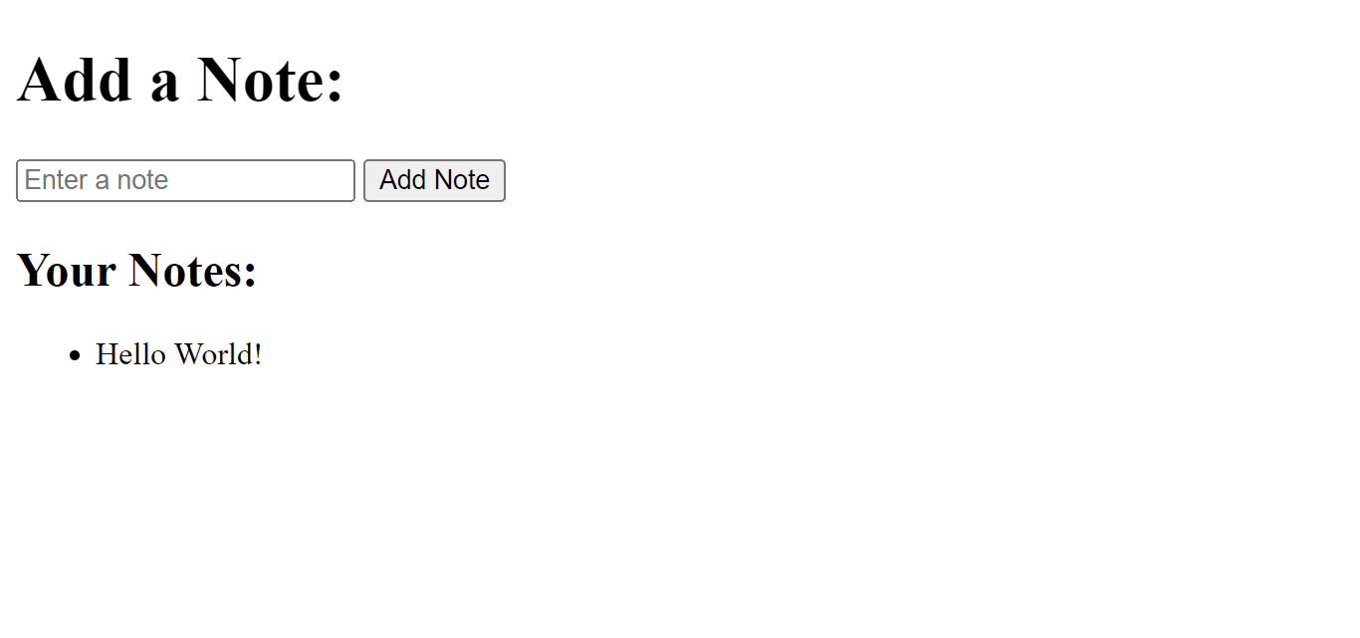
After Refactoring and Bug Fixing:

Slide 16
Conclusion:
In the meticulous process of identifying and addressing bugs, the Flask Notes Tasking App has undergone a significant transformation, emerging as a more resilient and feature-rich application.
Through diligent bug hunting and systematic resolution, we have fortified the app's core functionalities, ensuring seamless form submission, robust data persistence, impeccable HTML structure, and comprehensive error handling mechanisms.
These enhancements collectively elevate the user experience to unprecedented heights, imbuing the application with a newfound level of reliability and usability.
By meticulously tending to each bug and implementing precise solutions, we have sculpted a platform that not only meets but exceeds expectations, setting a new standard for excellence in Flask development.
With every obstacle overcome and every bug vanquished, the Flask Notes Tasking App stands as a testament to the power of perseverance, innovation, and meticulous attention to detail.
As users engage with the app, they can do so with confidence, knowing that it has been fortified against the vagaries of software bugs, ready to serve their note-taking needs with unparalleled efficiency and reliability.

Slide 17

THANK YOU

